Slide 1
patroMedi

Slide 2
Project analysis slide 2
Problem Statement
An Application that connects Hospitals, Patients, Charities and Donors where by a patient can book appointments online with hospitals and Charities can help the patients with donor’s aid monetarily.
This application will save the time in scheduling an appointment of a patient and it further enables to provide the quality treatment to weaker section of the society with the help of charities.

Slide 3
Approach
We worked on the underline statement that if any patient(homeless person) wants to visit a doctor he can use this application , make his valid user account .
Once the account has been created he can book an appointment for doctor by selecting city where he is.
There is receptionist who will add slots for doctor
Also if the patient who has booked an appointment doesn’t have funds for his treatment then receptionist will send his request to charities asking for funding.
Charities have funds accumulated by donation received from donors.
Volunteers are responsible to publish newsletter on mail to donors.
Donors have privileges to fund charities of there choice.

Slide 4
Approach
Patient will easily go to doctor for whom he had booked the appointment .
Doctor will diagnose him and will make sure if he requires blood then immediately forward his record to nurse who in turn will request blood from the blood bank incharge.
Blood bank incharge has an inventory of blood where he stores and maintain all the blood types and quantity.
On receiving request from nurse he will send the blood.

Slide 5
Why Choose patroMedi ?
One Step solution for taking appointments
Verified Patients
Verified Donors
Linked Charities to fund in need patients.
Linked Donors to fund charities.
Easy blood bank access.

Slide 6
Project analysis slide 3
Object Model

Slide 7
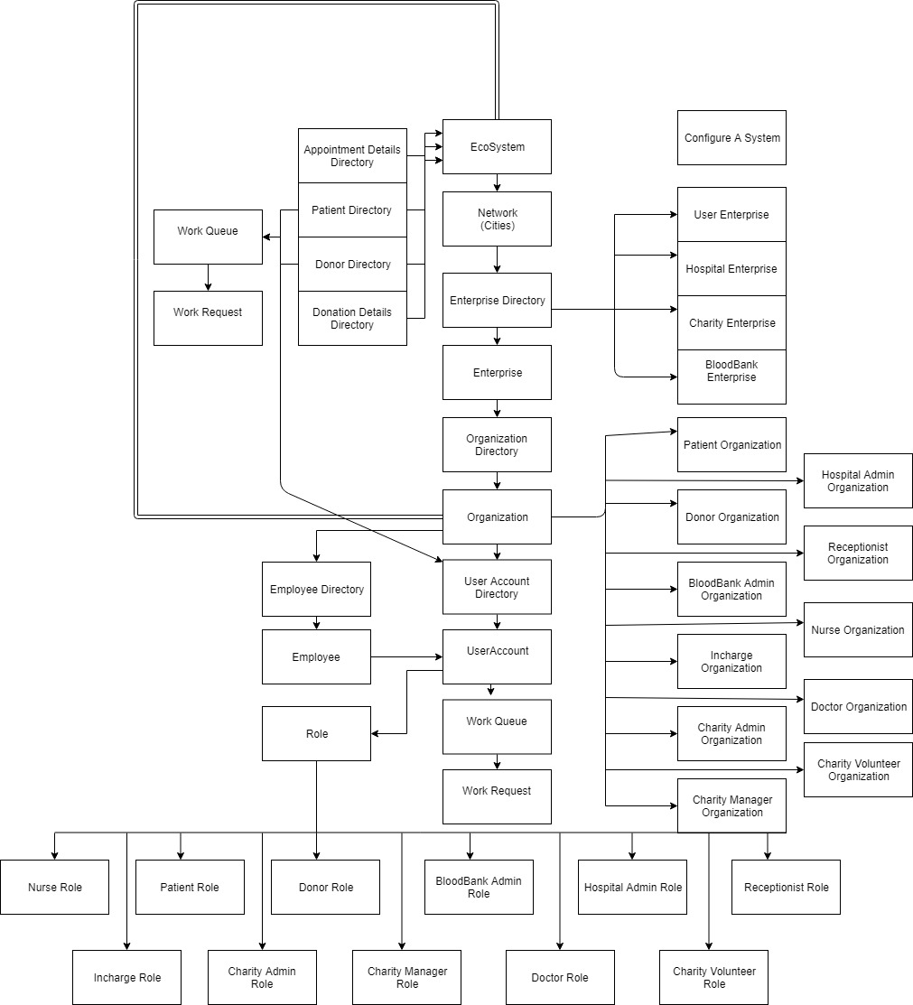

Slide 8
Patient Use Case
Patient can create there user account and password(a valid email address is required for verification)
Patient can book appointment in choice of his/her city.
Patient can also view his or her appointment history.

Slide 9
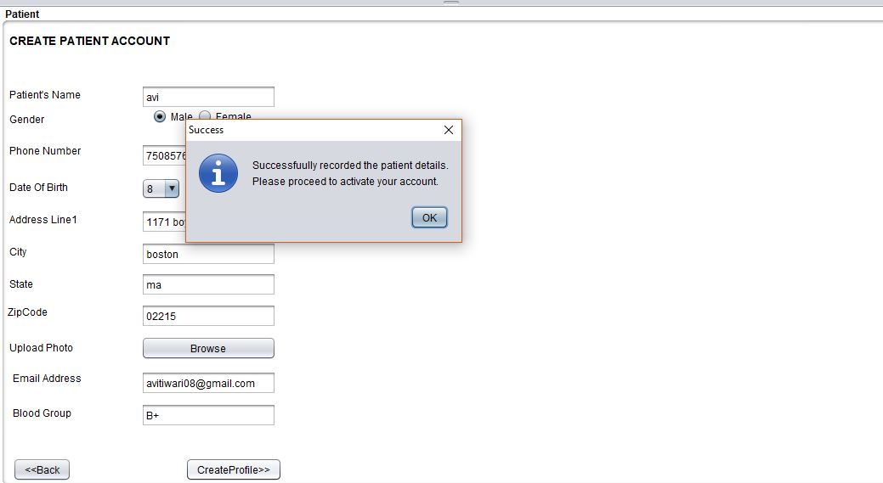

Slide 10
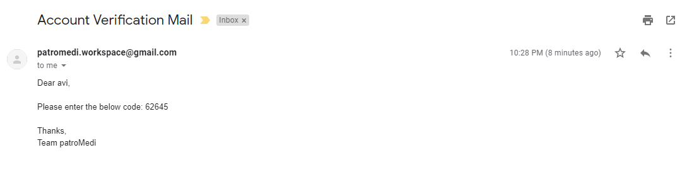
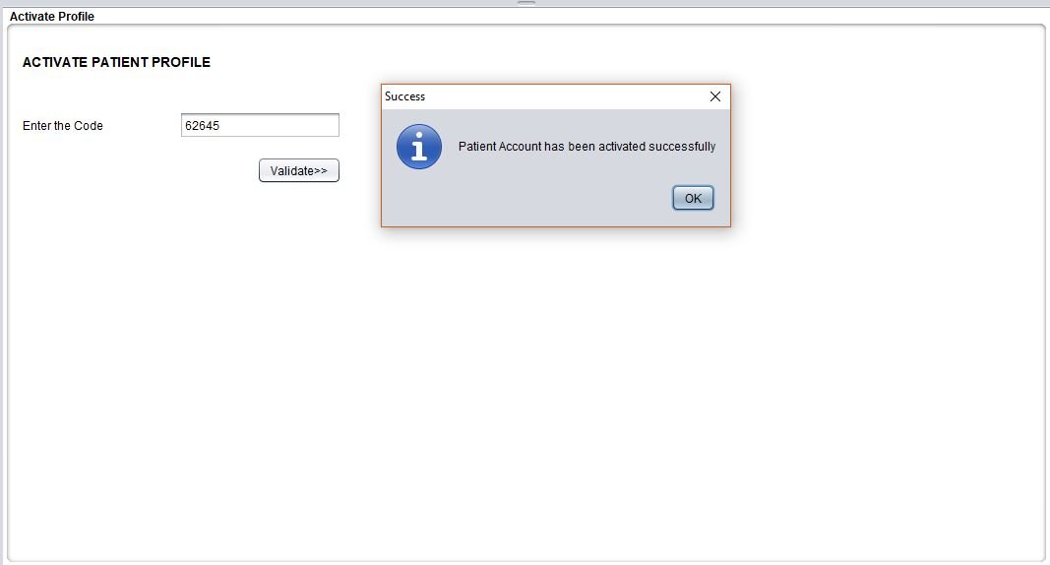

Slide 11
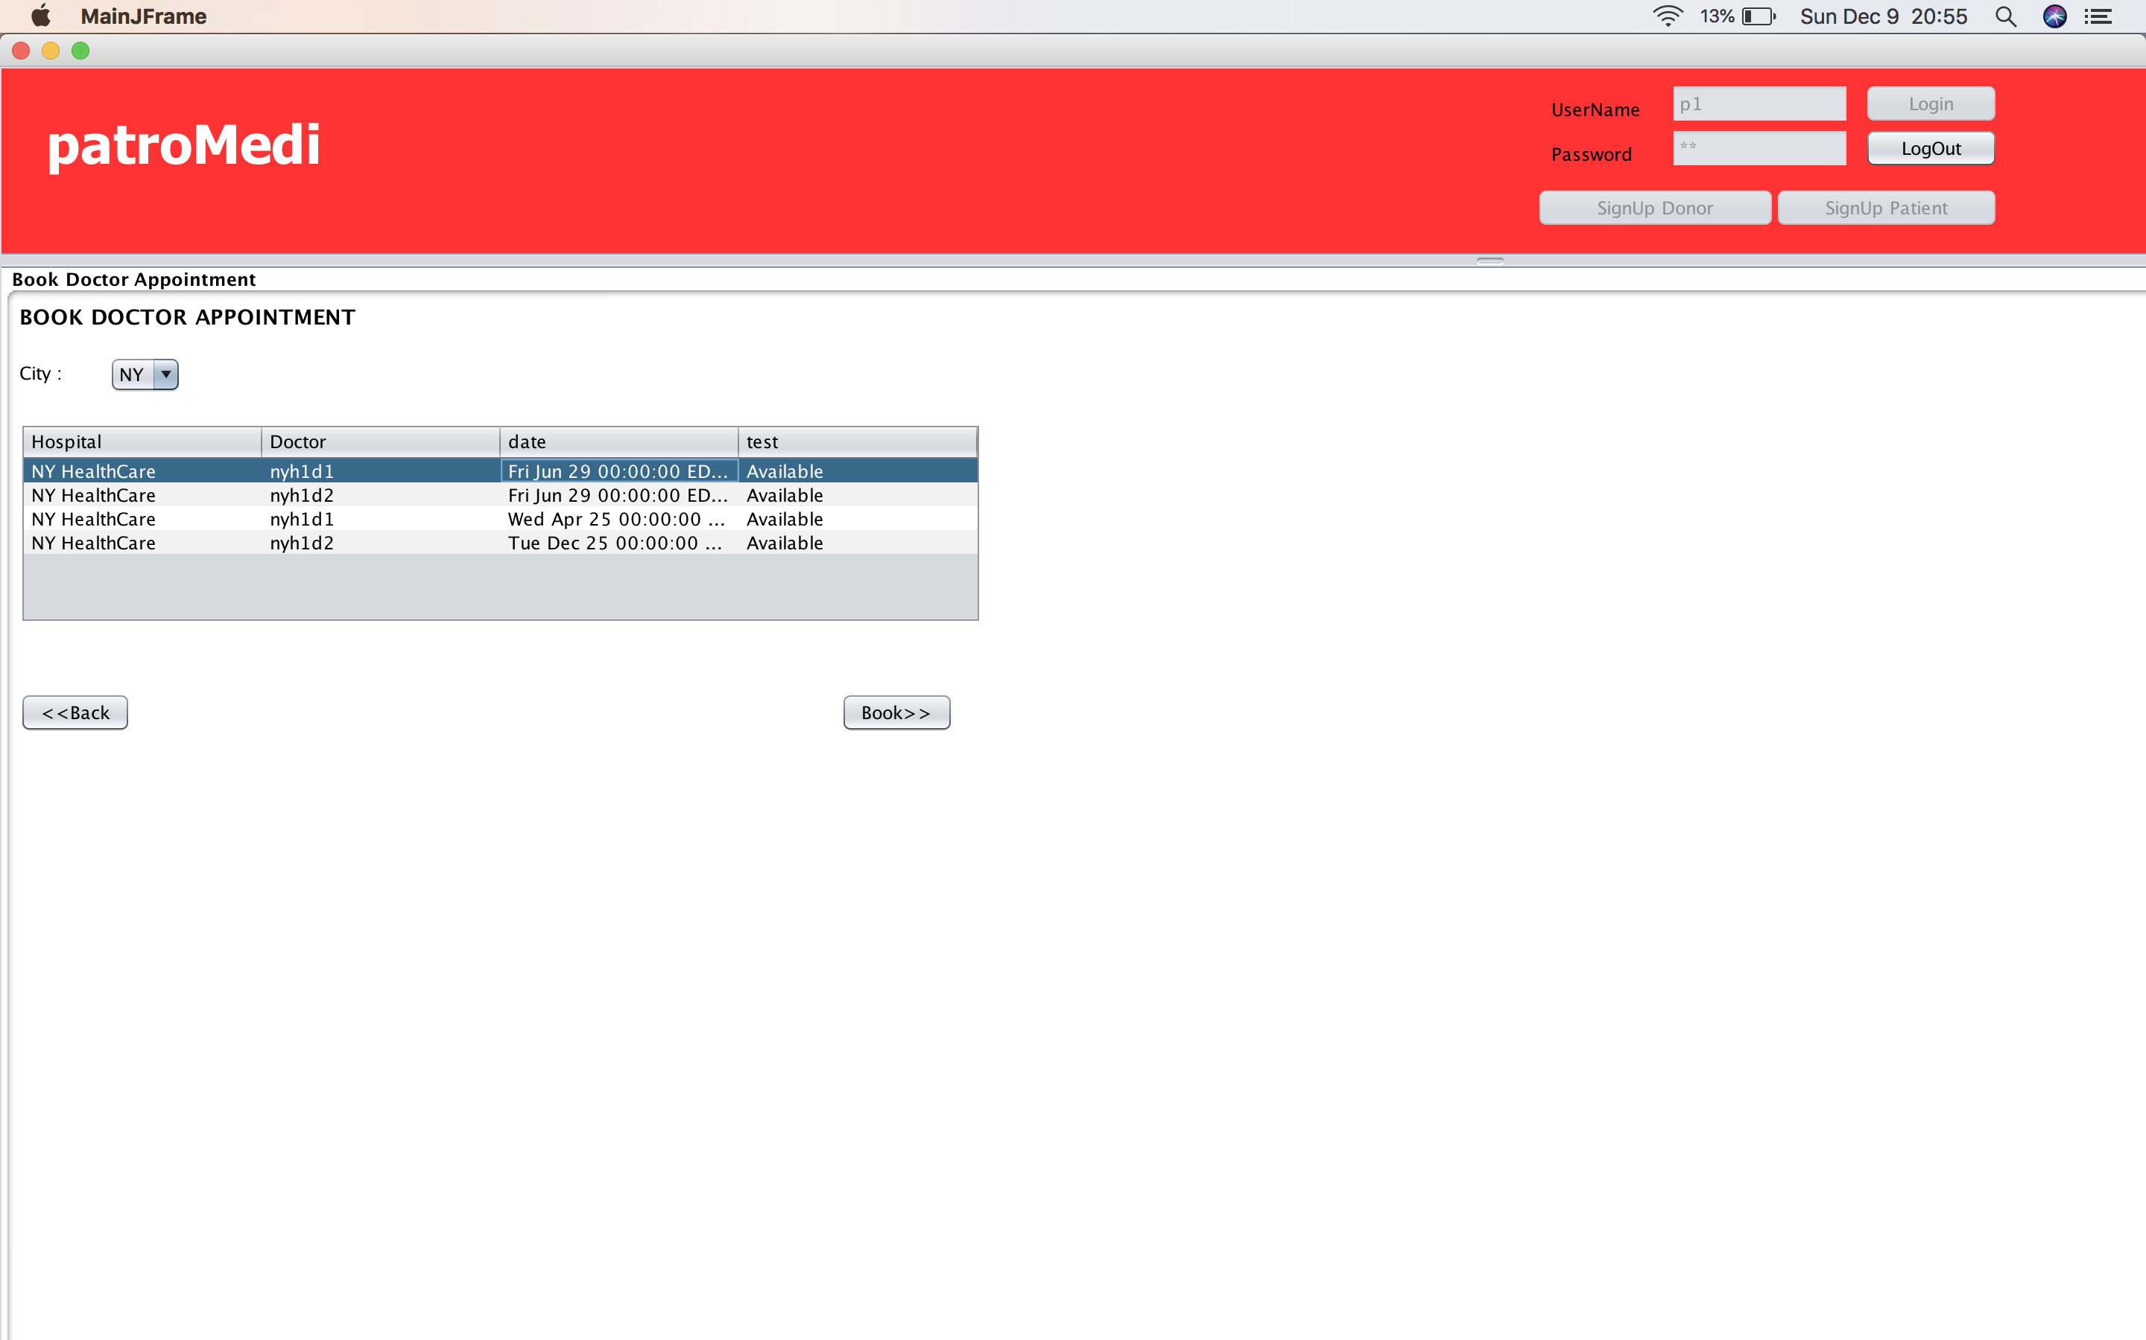

Slide 12
Donor Use Case
Donor can create there user account and password(a valid email address is required for verification)
Donor can donate amount as per his will to charity of his choice.
Donor can view his donation history.
Donor will receive a newsletter from volunteer requesting donation.

Slide 13
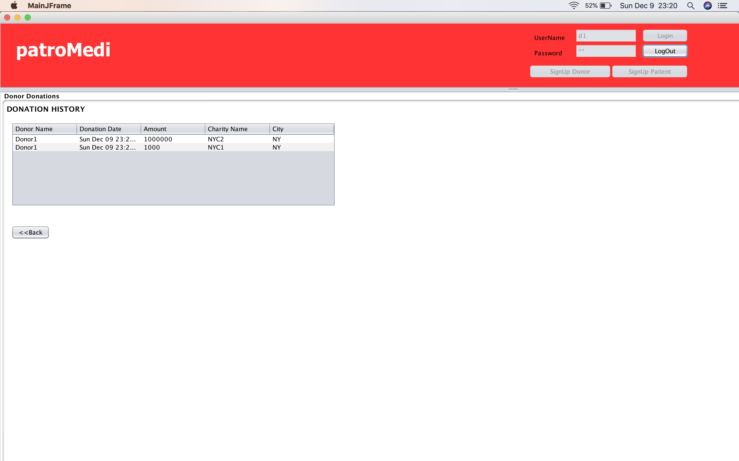

Slide 14
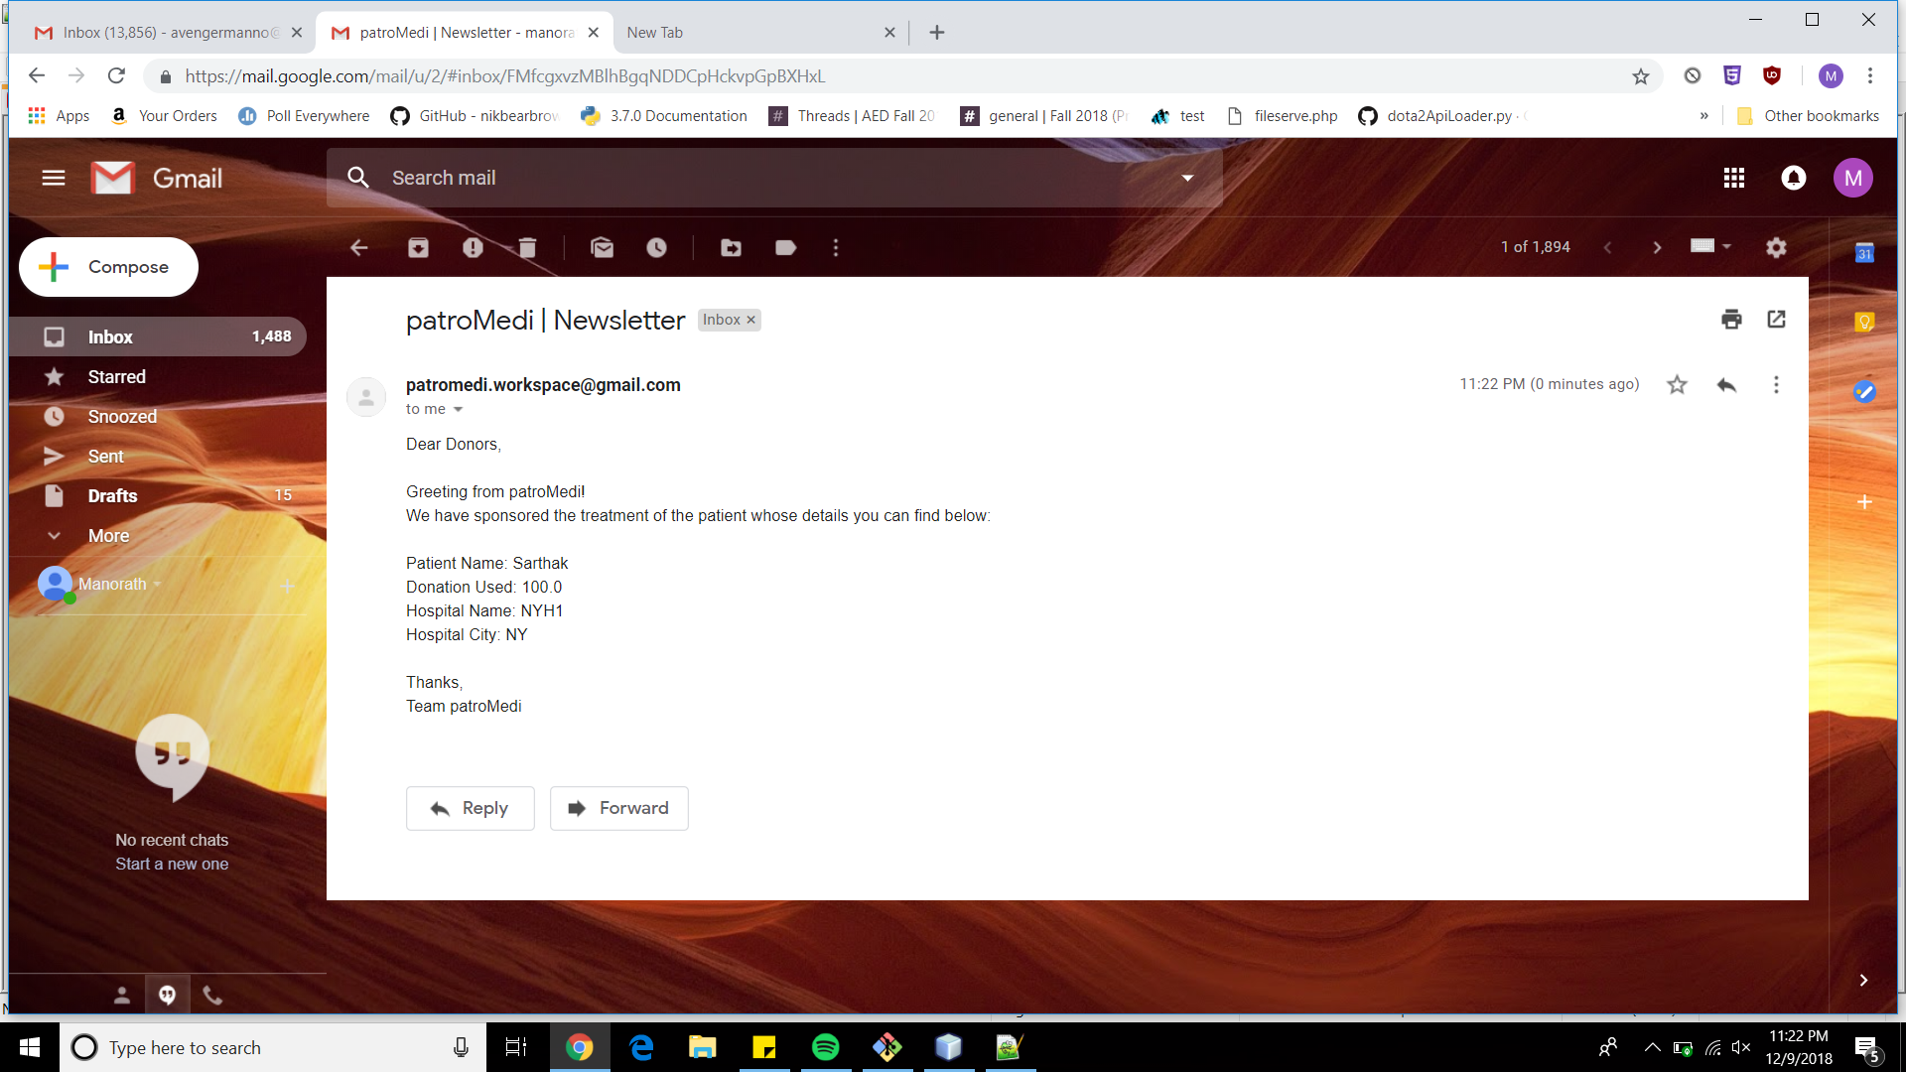

Slide 15
Receptionist Use Case
Receptionist will add Doctor slots .
Receptionist will also forward request to charity requesting donation for the patients in need.
Receptionist will accept or reject patient appointment.
Receptionist can view funding request status.

Slide 16
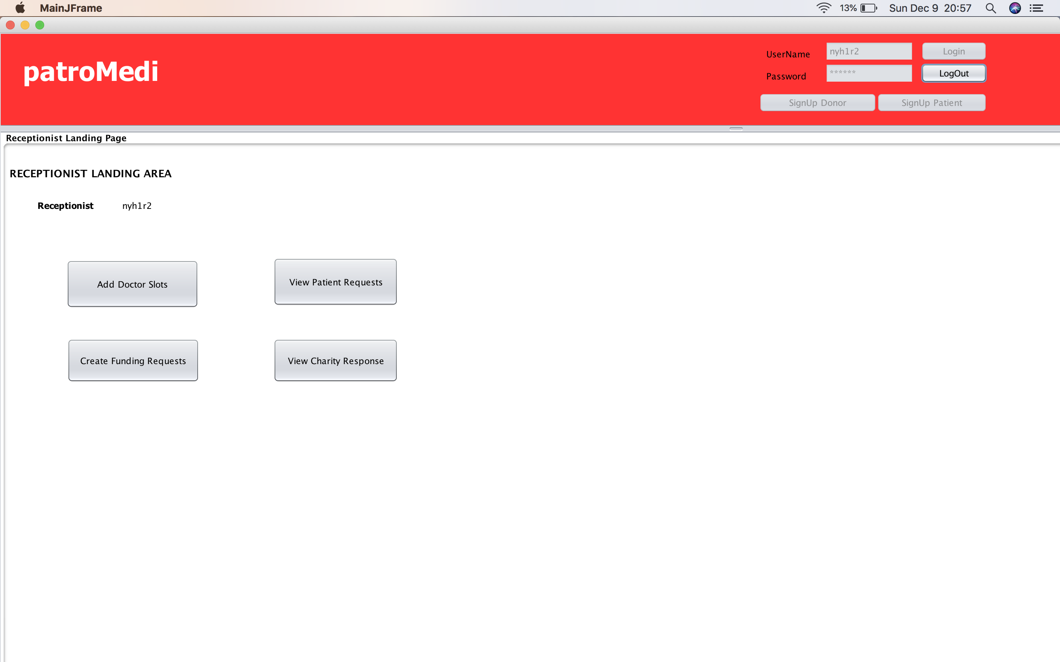

Slide 17
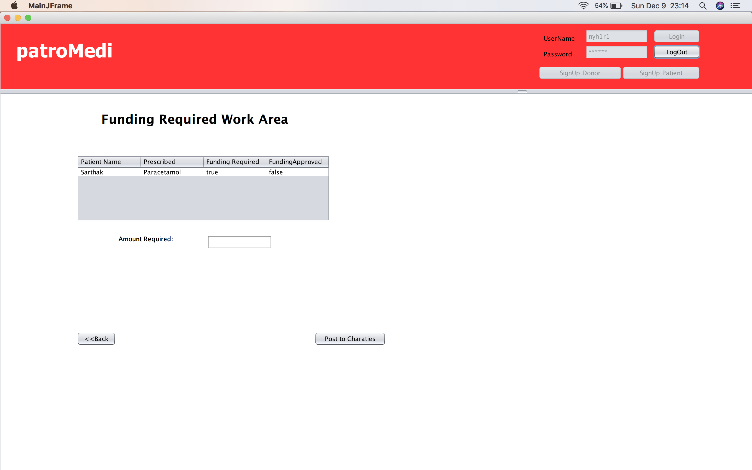

Slide 18
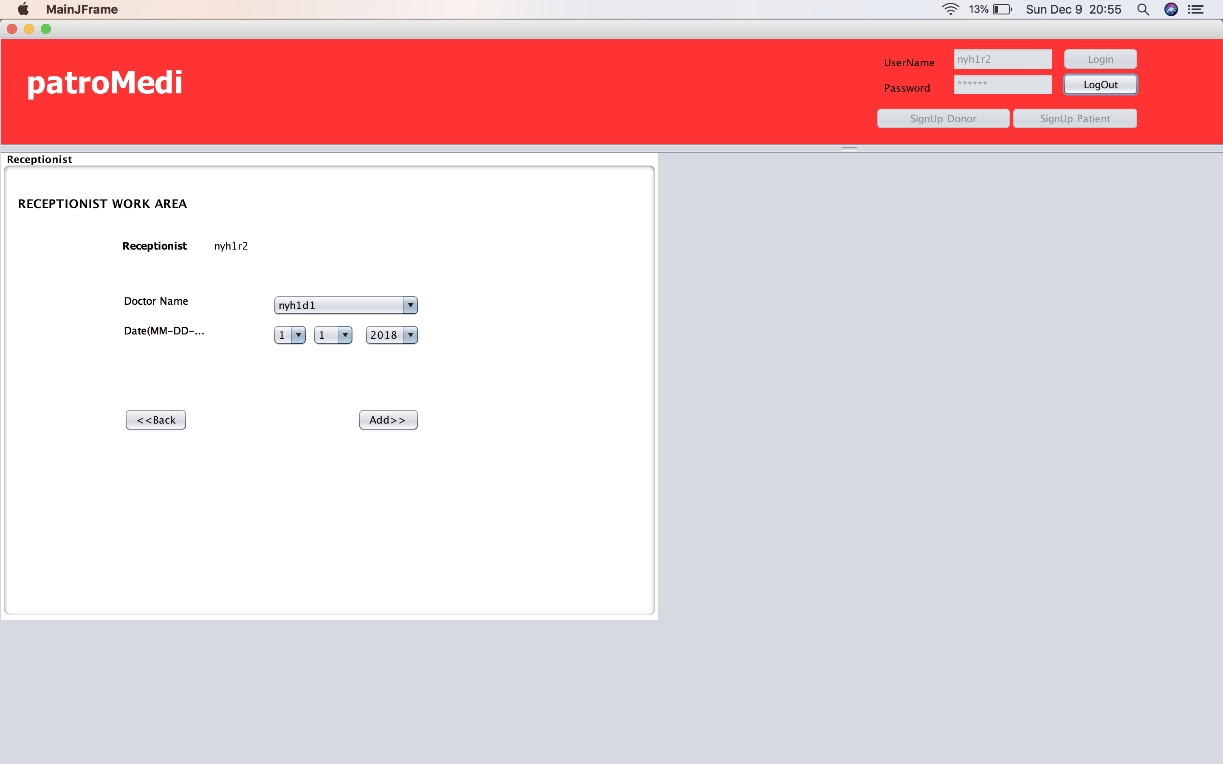

Slide 19
Doctor Use Case
Doctor will provide his prescription and will check if blood or donation is needed.
If blood or donation required application will forward it to nurse or receptionist respectively.

Slide 20
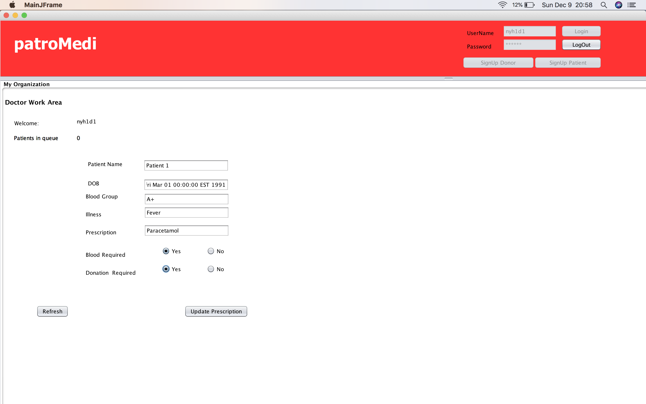

Slide 21
Nurse Use Case
Nurse will forward it to blood bank with blood type and quantity required.
Nurse will also receive acknowledgement

Slide 22
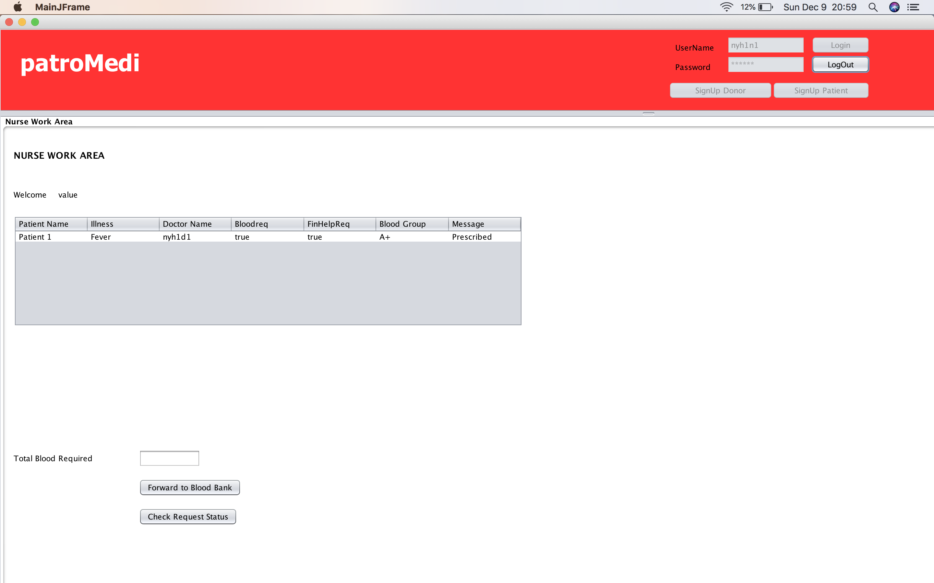

Slide 23
Bloodbank Incharge Use Case
Blood bank incharge will check if the requested blood is in stock and based on it will provide status to nurse.
Blood bank incharge will also maintain bloodbank inventory where he will add bloodquantity corresponding to bloodtype.

Slide 24
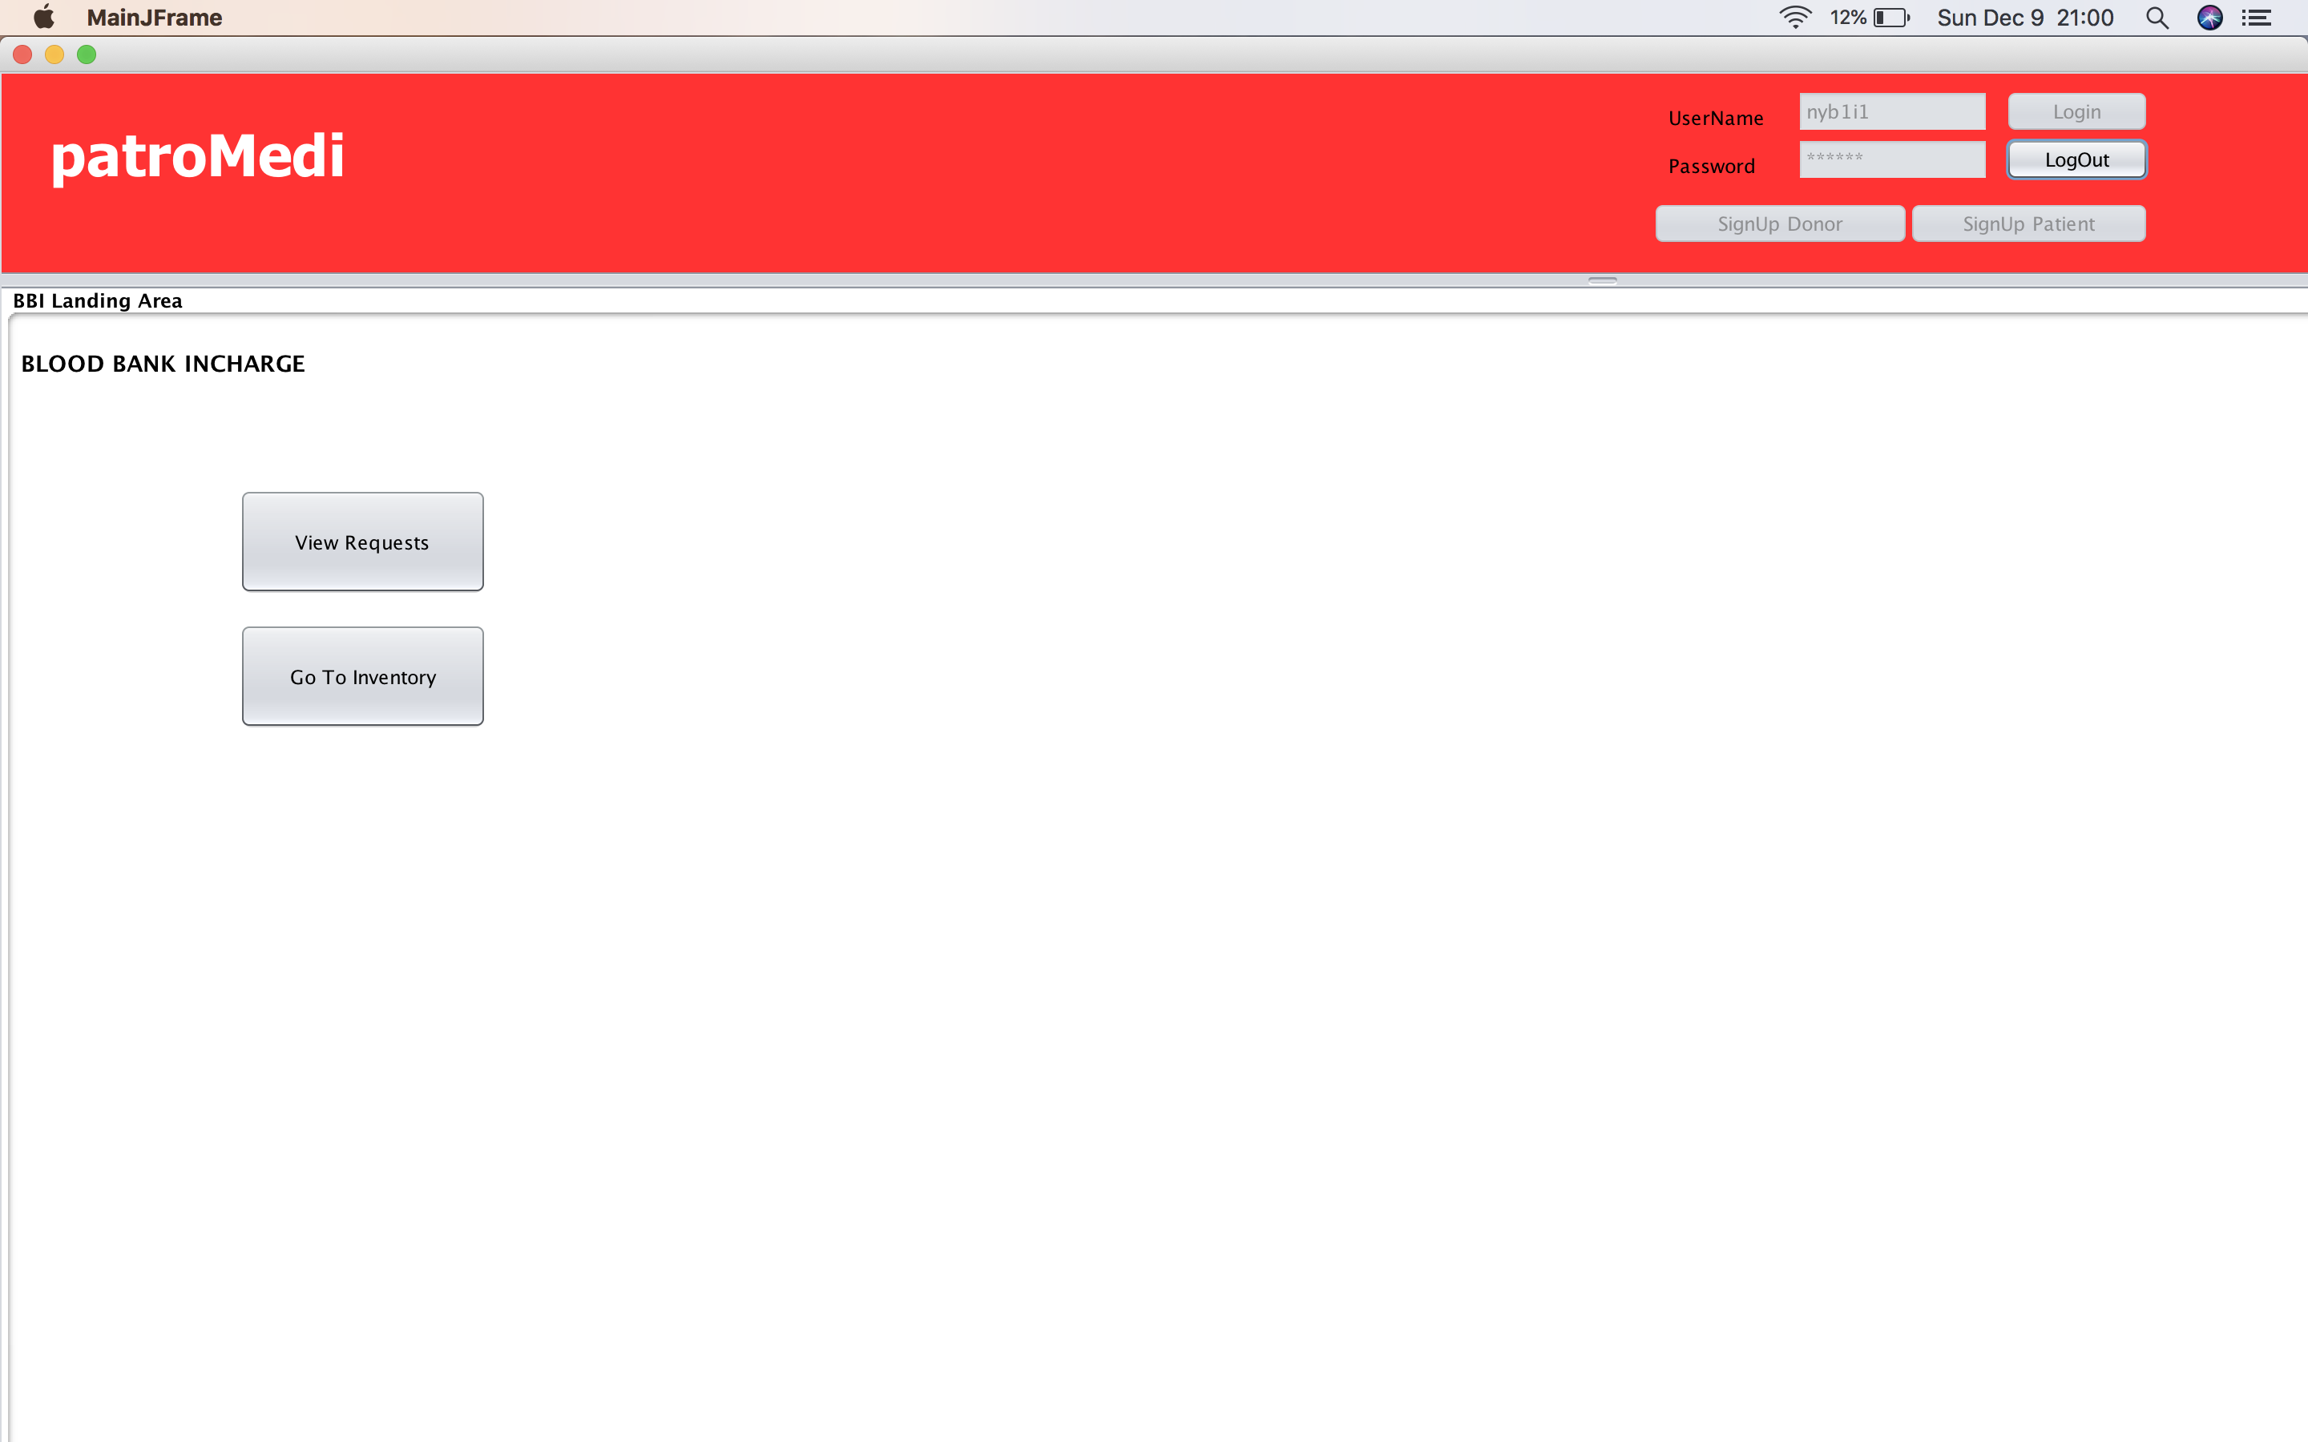

Slide 25
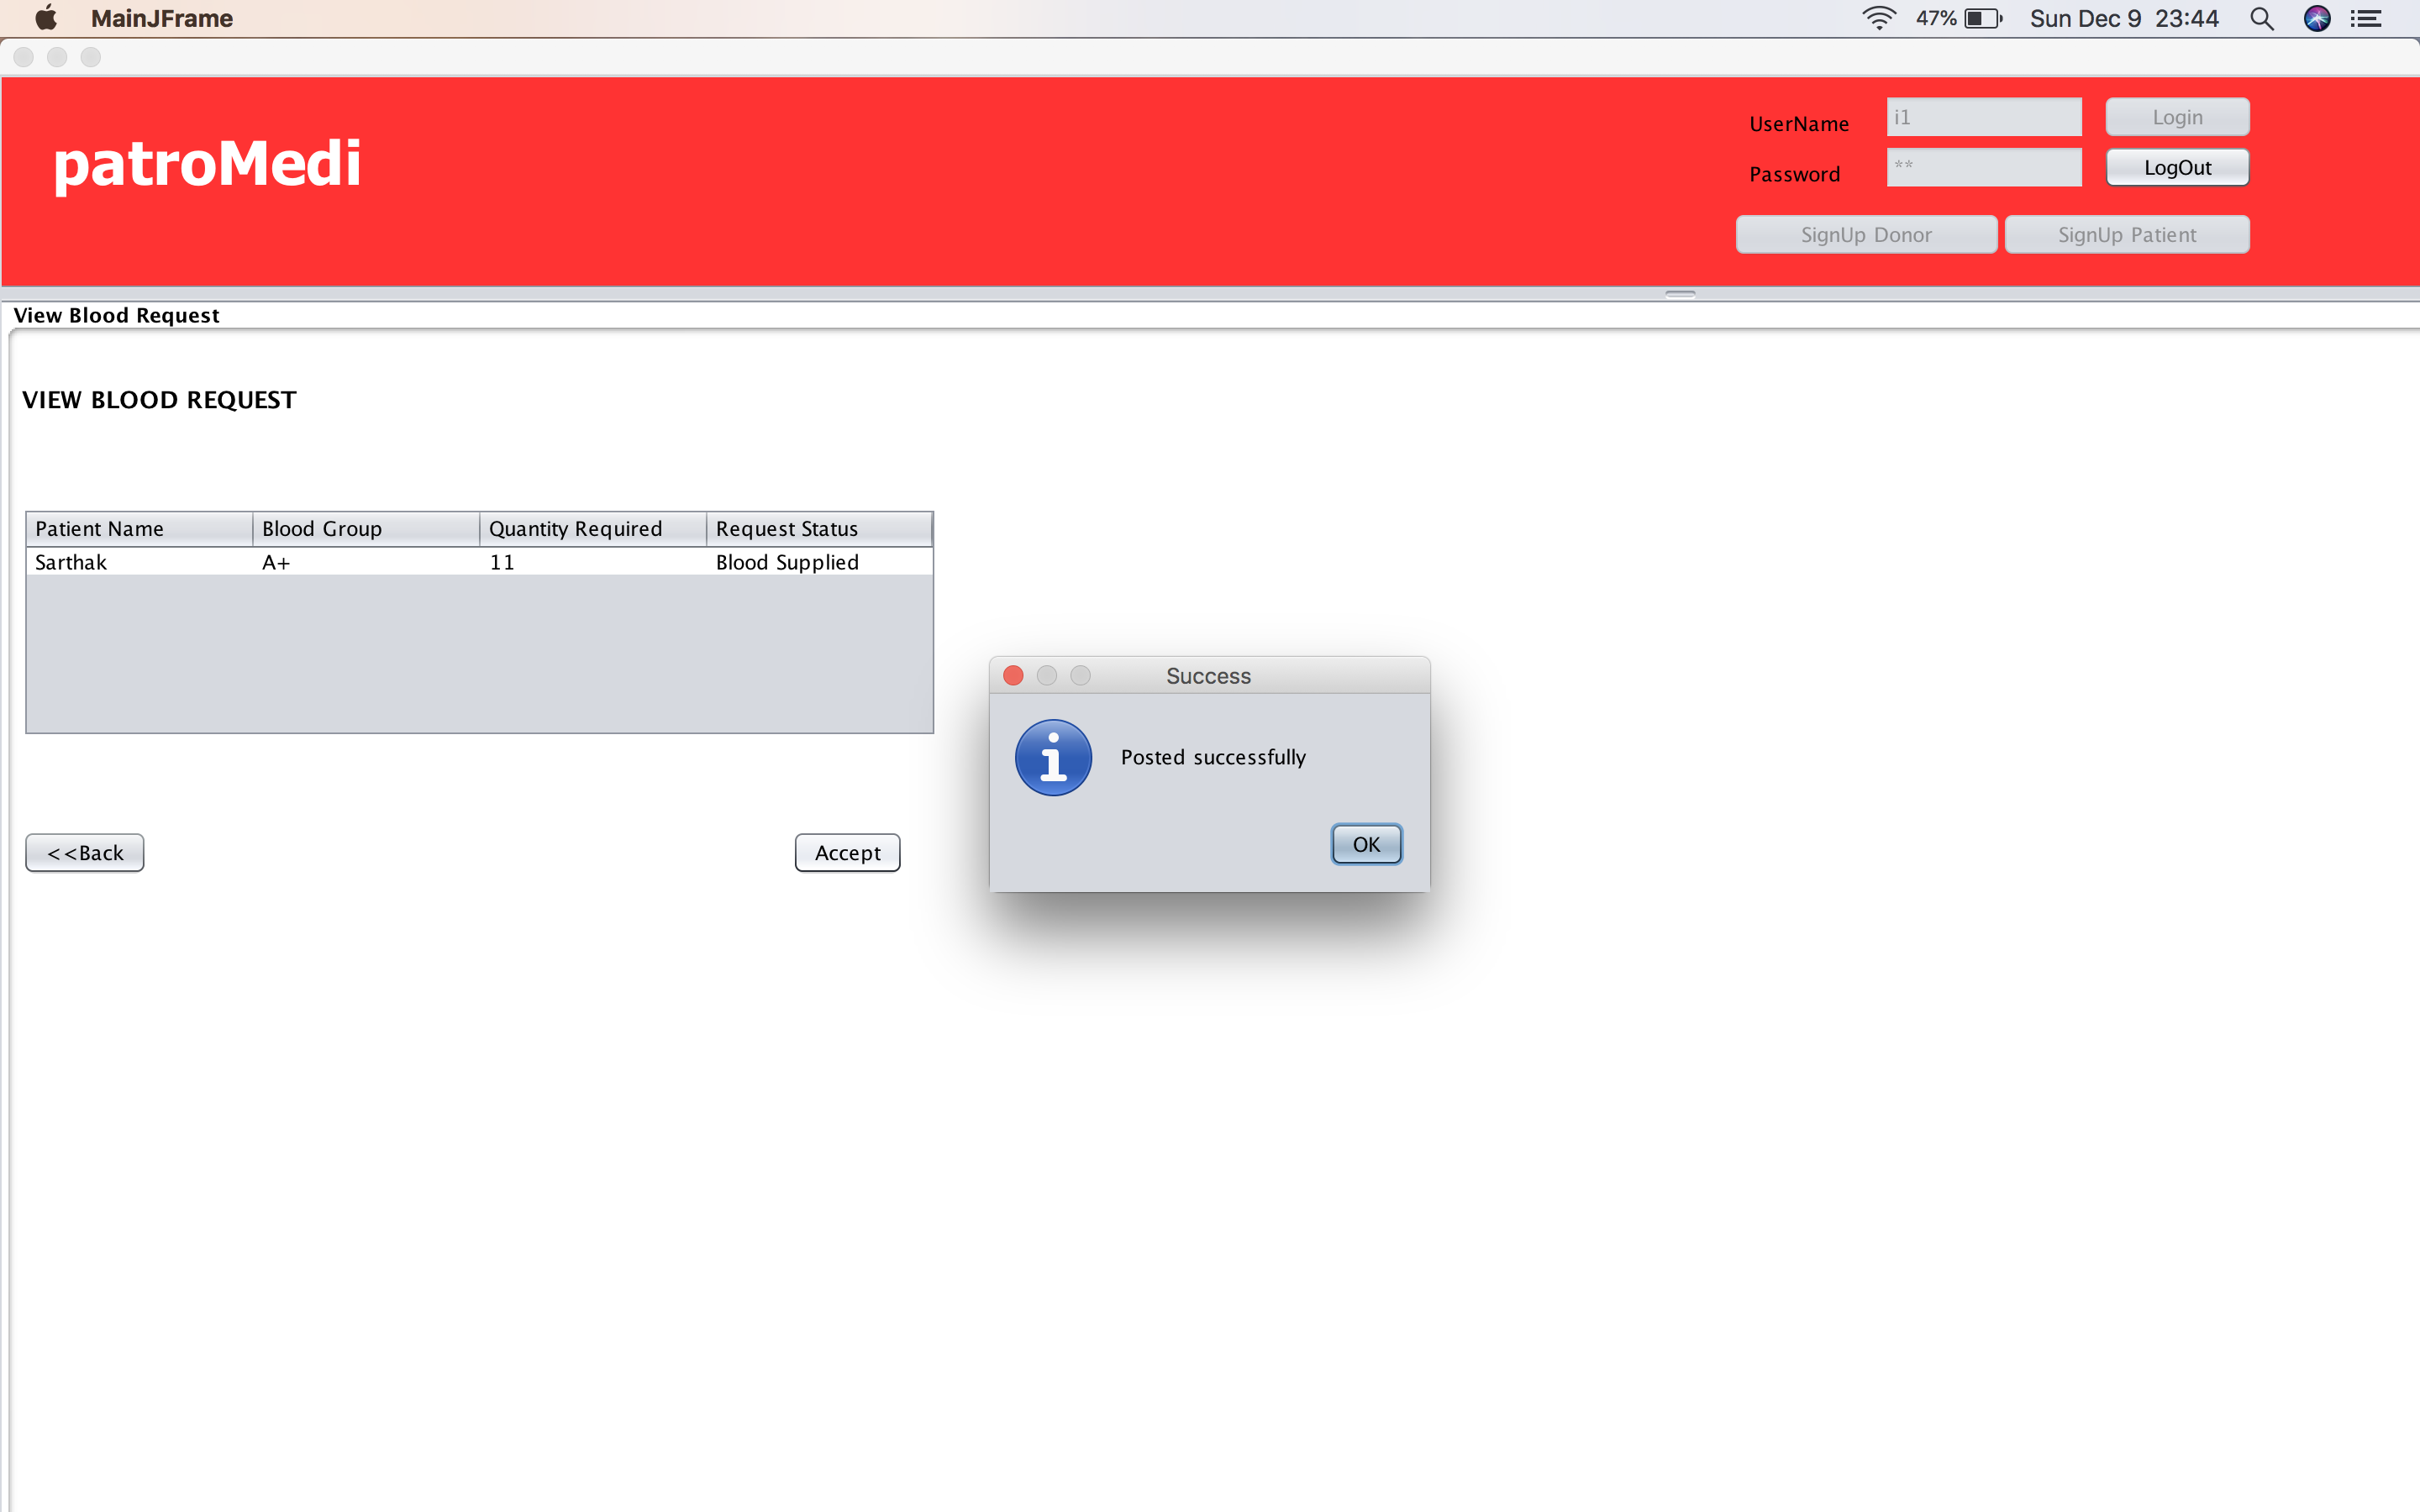

Slide 26
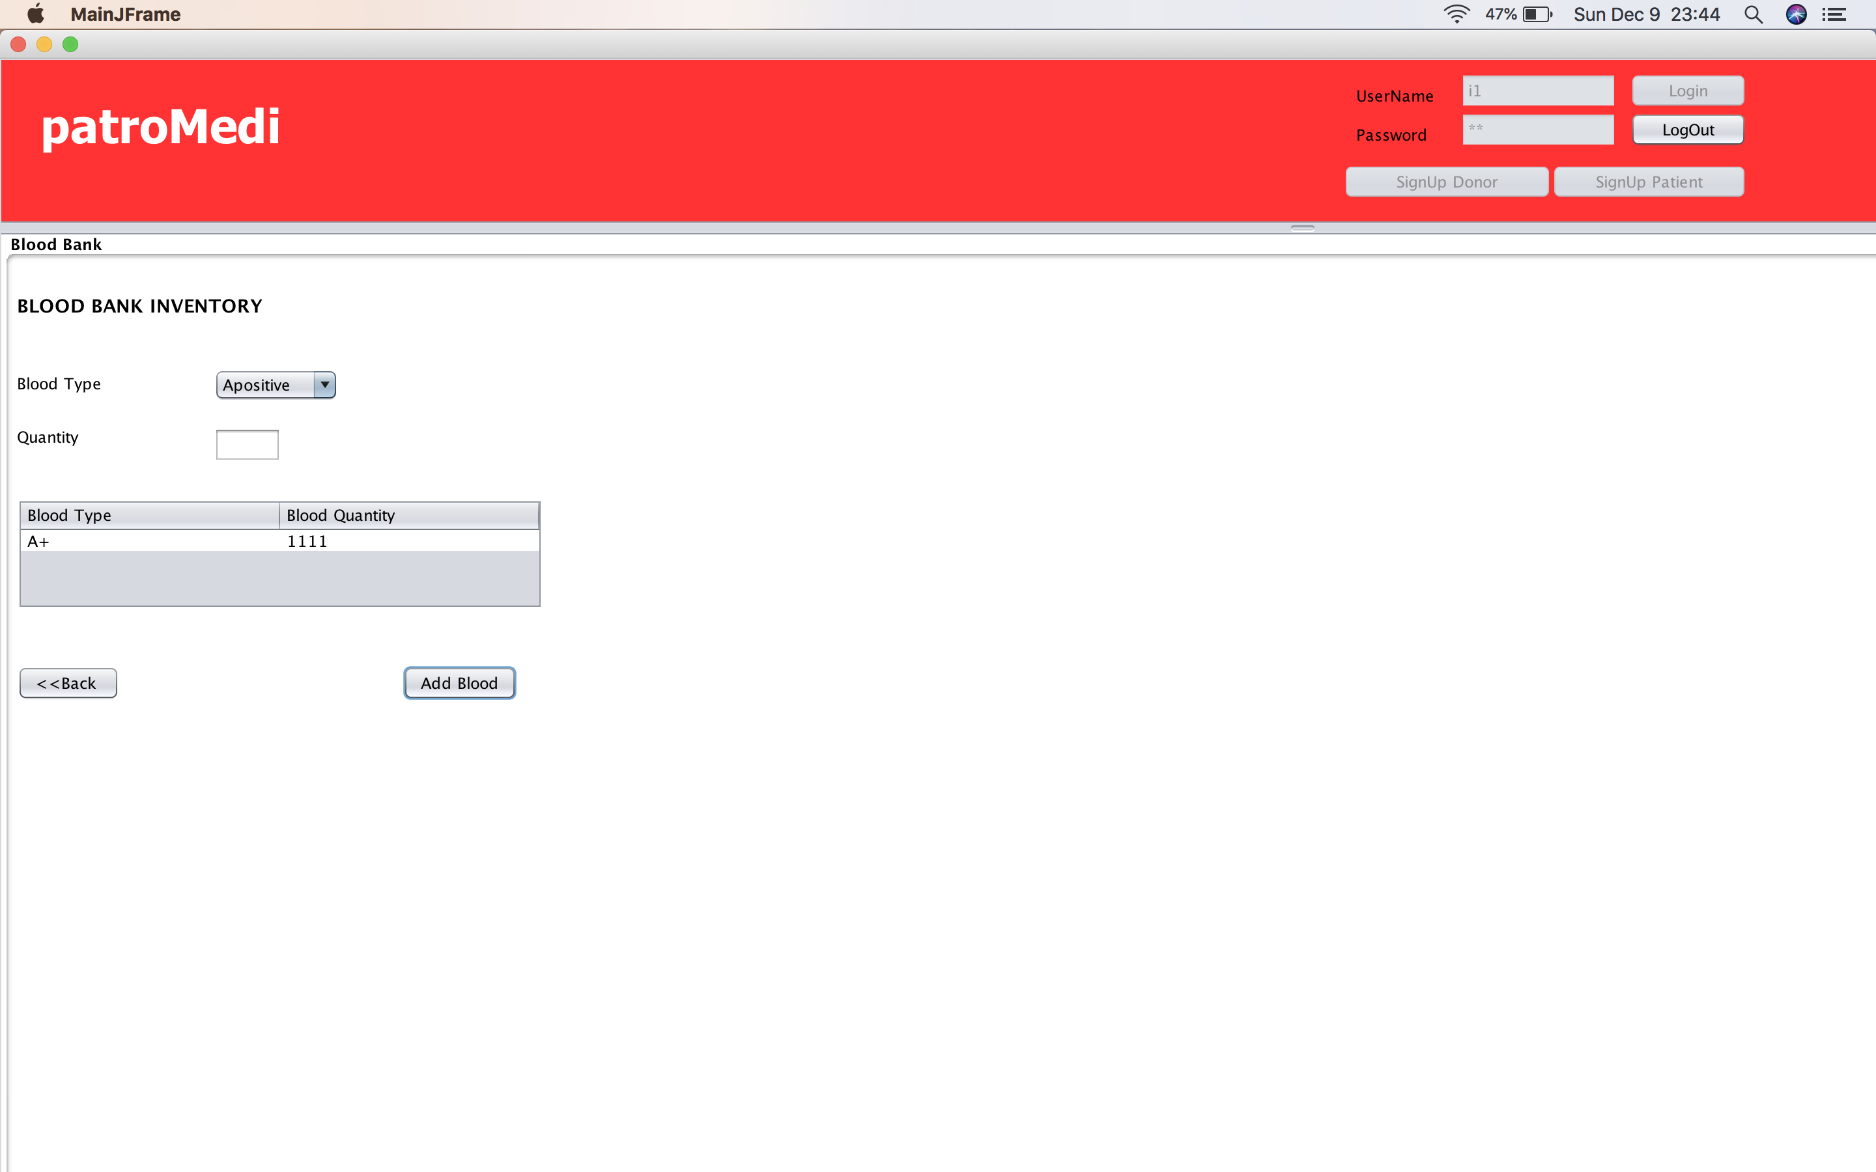

Slide 27
Charity Manager Use Case
Charity manager can view all the funding request received from the hospitals in the network i.e. City.
On the basis of availability of funds present with charity, the manager can accept or reject the funding request received.

Slide 28
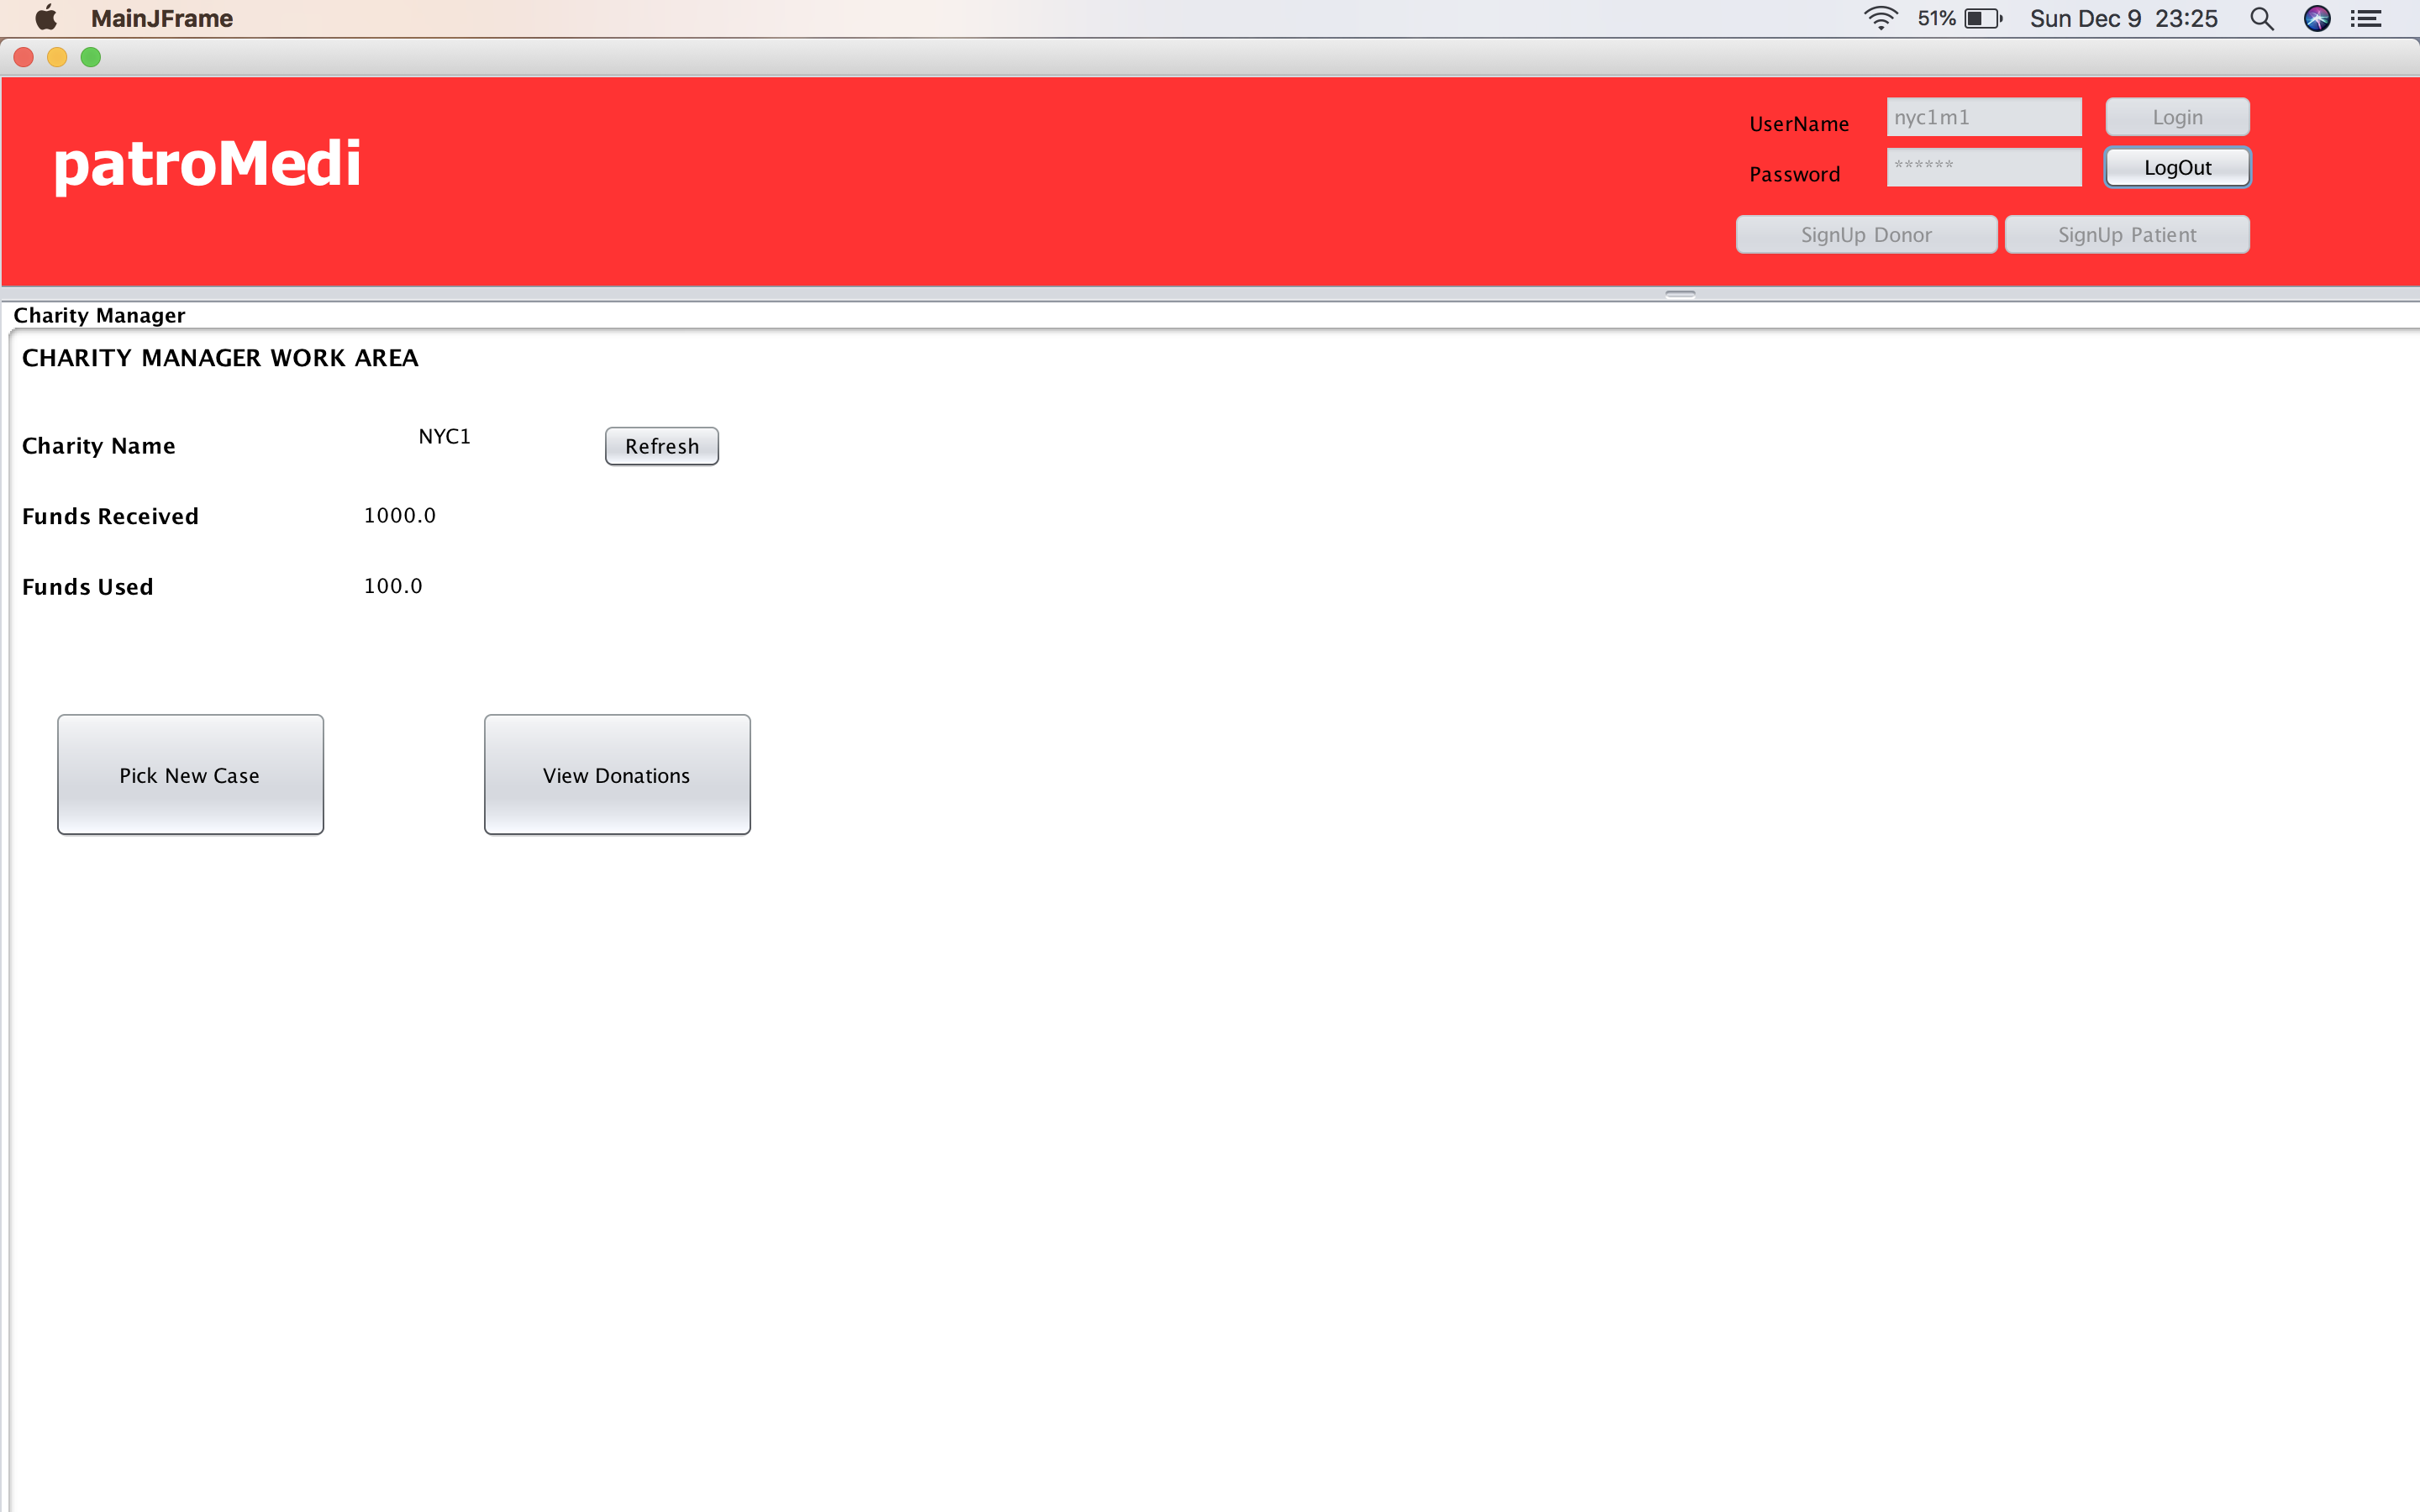

Slide 29
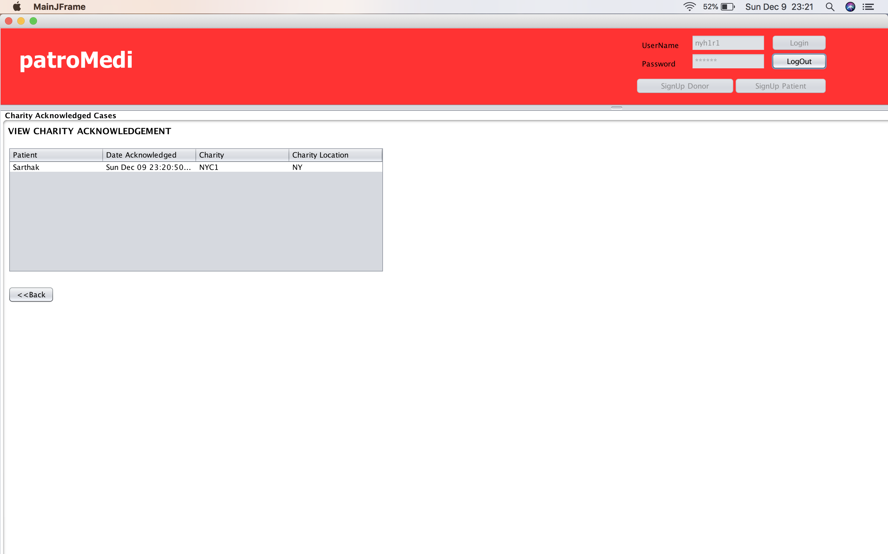

Slide 30
Volunteer Use Case
All the request accepted by the charity manager will be fetched by volunteers who in-turn will publish a newsletter to donors associated with that particular charity.

Slide 31
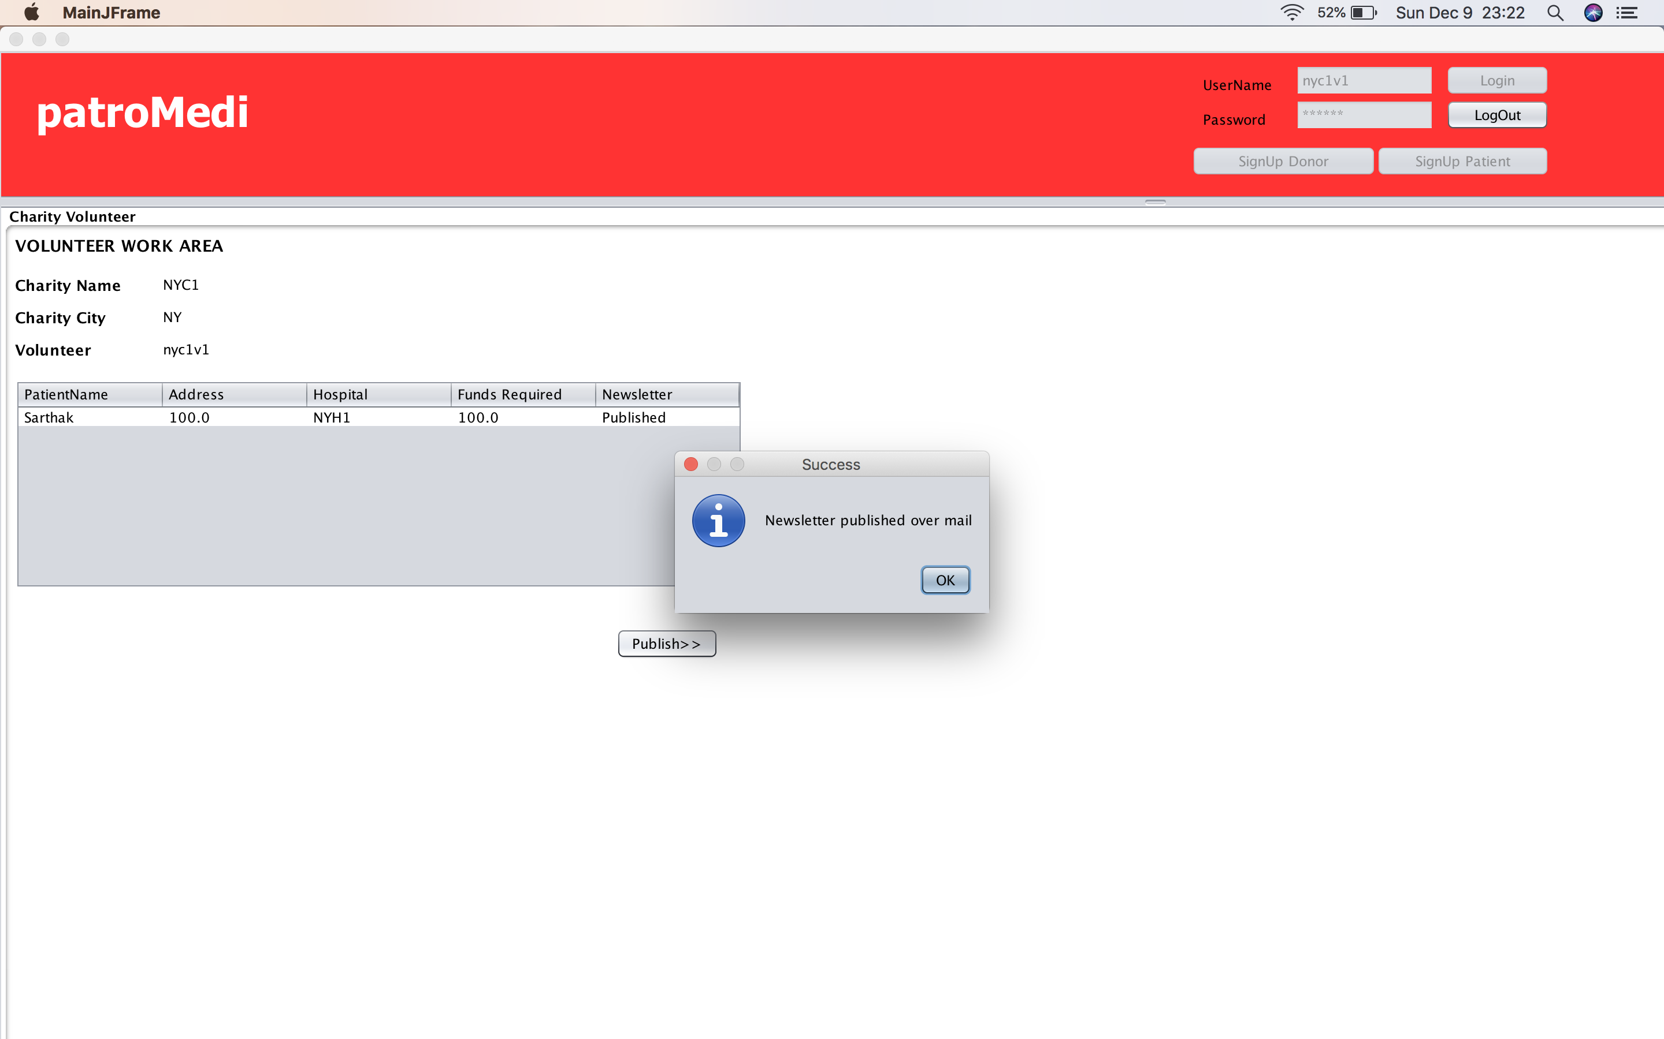

Slide 33
Systemadmin Use Case
Systemadmin has privileges of adding, managing cities/enterprises/patients/donors.
Systemadmin can use analytics function to draw the following:
Top Donors
Top Charities
Most active patients
Most visited Hospitals
Most active Charity
Most Visited Doctor

Slide 34
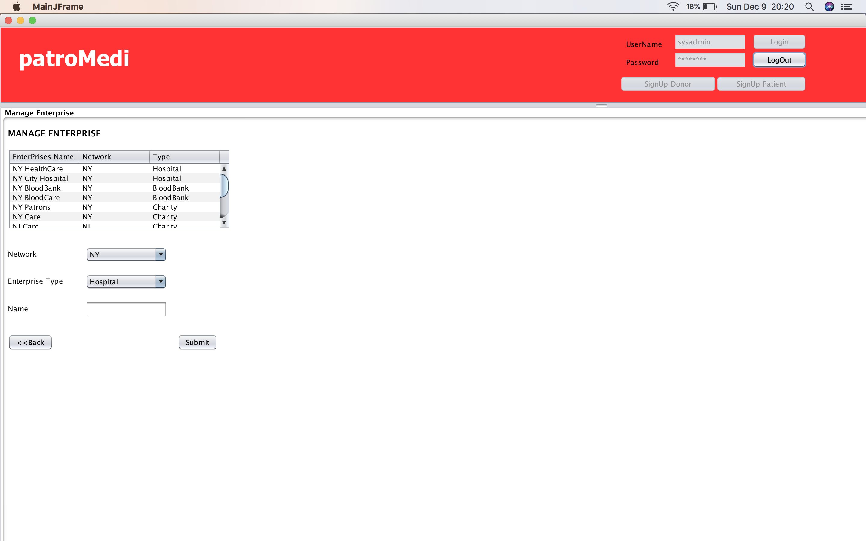

Slide 35
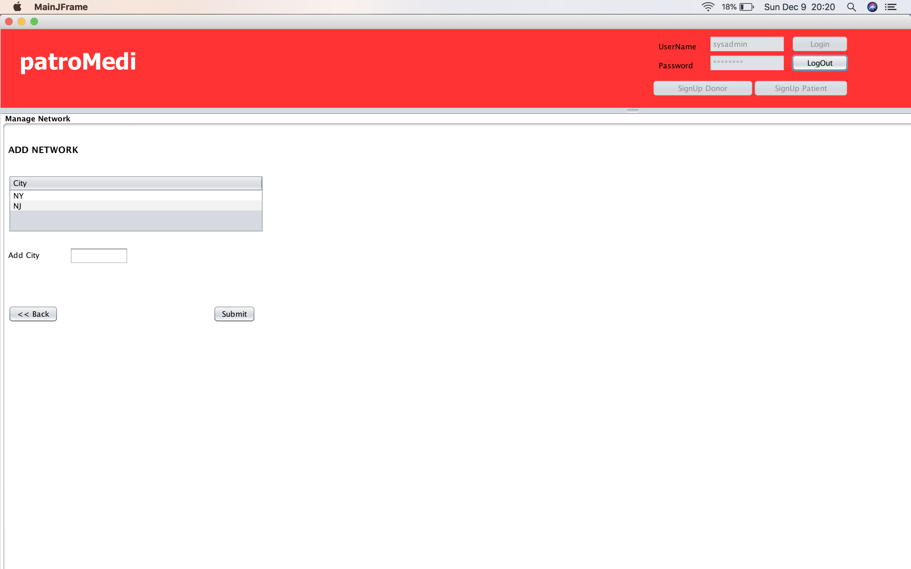

Slide 36
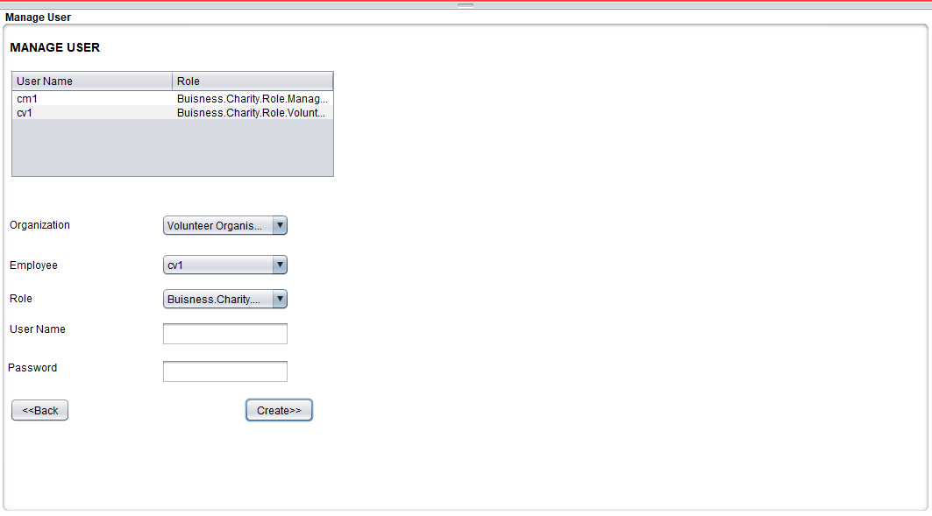

Slide 37
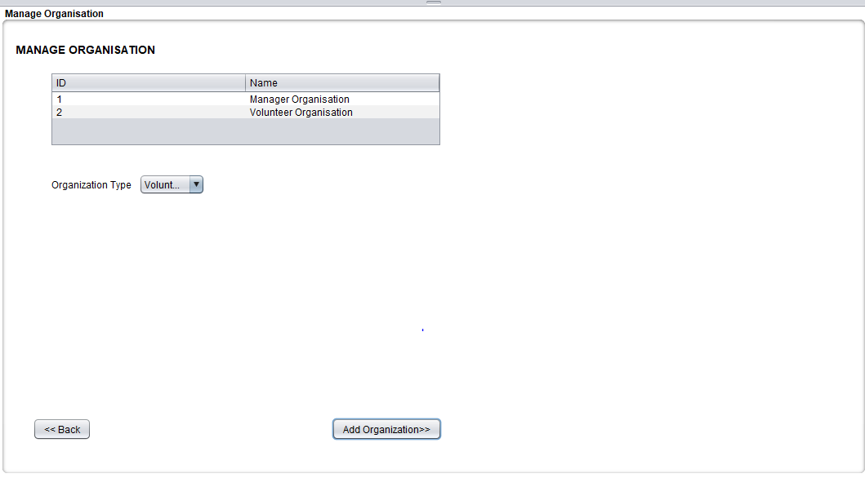

Slide 38
Project analysis slide 4
Project Analysis
Most visited Hospitals
Top Donors
Most active Charity
System Admin
Top Charities
Most active patients
Most Visited Doctor

Slide 39
Thank You

